Slide 1
Gleniffer PE Health and Wellbeing Guide

Slide 2
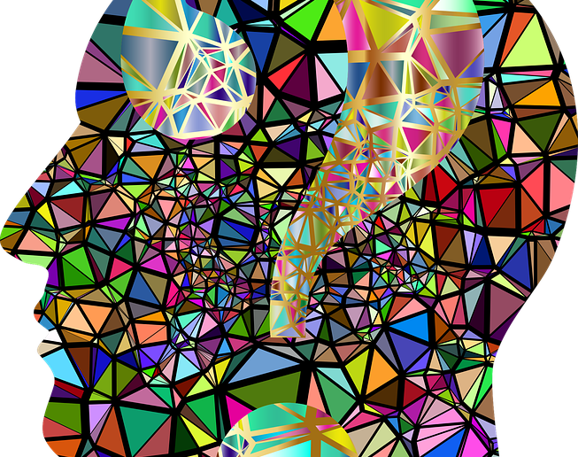
Introduction
As we are going to be off school for a significant period, this document has been created to help you stay physically active and will also support your mental wellbeing.

Slide 3
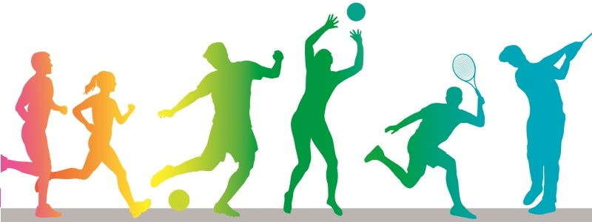
Physical Activity
Children and young people need to do 2 types of physical activity :
aerobic exercise
exercises to strengthen their muscles and bones
Children and young people aged 5 to 18 should:
aim for an average of at least 60 minutes of moderate intensity physical activity a day
take part in a variety of types and intensities of physical activity across the week to develop movement skills, muscles and bones
reduce the time spent sitting or lying down and break up long periods of not moving with some activity. Aim to spread activity throughout the day. All activities should make you breathe faster and feel warmer.
https://www.nhs.uk/live-well/exercise/physical-activity-guidelines-children-and-young-people/
This Photo by Unknown Author is licensed under CC BY-SA-NC

Slide 4
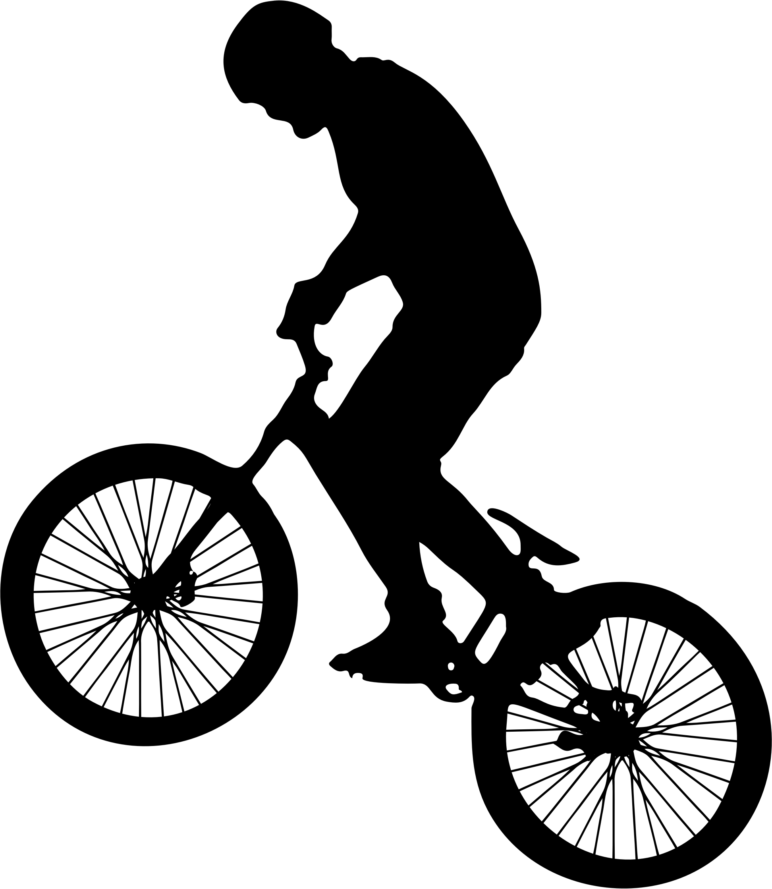
Moderate Activity
Examples of moderate intensity activities:
walking
riding a scooter
skateboarding
rollerblading
walking the dog
jogging
cycling on level ground or ground with few hills
There are other activities, but they are not possible to do during these times

Slide 5
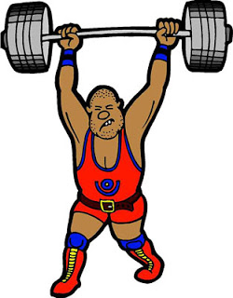
What activities strengthens bones and muscles?
Football
Basketball
Dance
Resistance exercises with exercise bands, weight machines or handheld weights
Aerobics
Running
Badminton
Skipping with a rope
Martial arts
Sit-ups, press-ups and other similar exercises
A reminder that you should still follow social distancing guidelines if doing some of these activities!

Slide 6
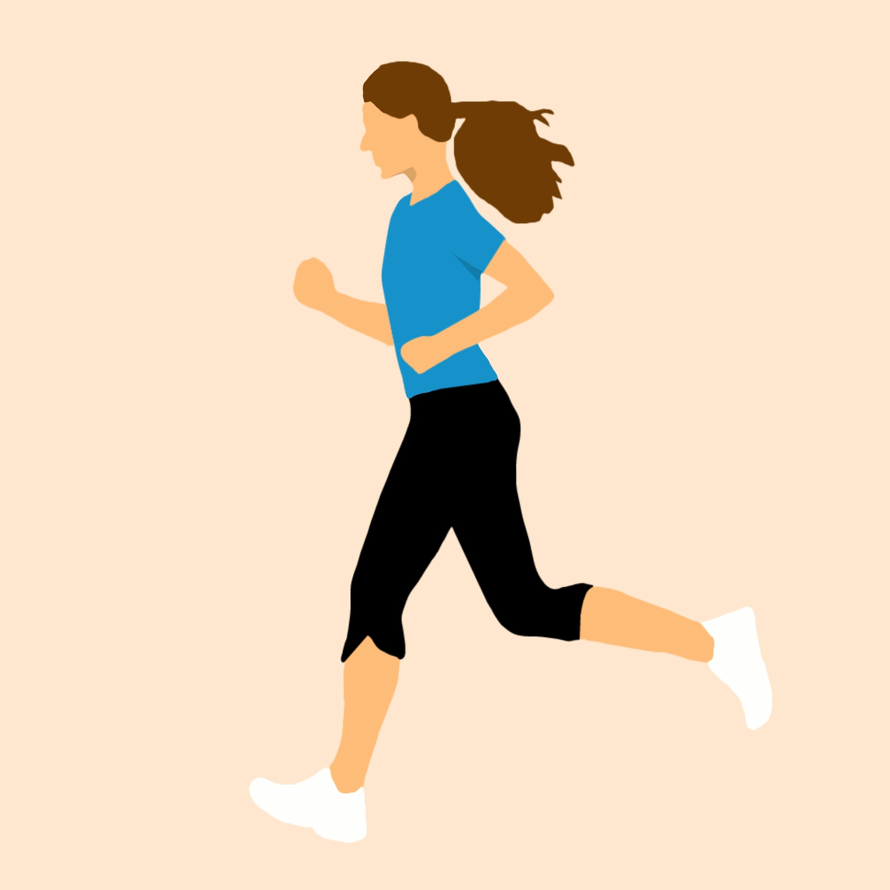
Couch to 5k
https://www.nhs.uk/live-well/exercise/couch-to-5k-week-by-week/
This programme is designed to help improve your running ability.
Please click on the link to check it out!

Slide 7
10 minute Workouts
Click on the links below to access different workouts looking at specific muscle groups and cardio.
https://www.nhs.uk/live-well/exercise/10-minute-abs-workout/
https://www.nhs.uk/live-well/exercise/10-minute-upper-arms-workout/
https://www.nhs.uk/live-well/exercise/10-minute-home-cardio-workout/
https://www.nhs.uk/live-well/exercise/10-minute-legs-bums-tums-home-workout/

Slide 8
The Body Coach
On this website you will find free home work outs.
Every weekday morning from 9am there is a live ‘PE’ lesson designed to keep you active. If you miss this, you can catch up!
https://www.youtube.com/c/thebodycoachtv

Slide 9
Football
Click the links below to access some football challenges and individual drills to improve skills.
https://www.youtube.com/watch?v=z7jP3moQi9c
https://www.youtube.com/watch?v=uQm7c7kLZds
https://www.youtube.com/watch?v=t87J9hlTaFc

Slide 10
Dance
Click the link below to access free Dance tutorials from Diversity.
You can also find lots on YouTube!
https://20dv.co.uk/

Slide 11
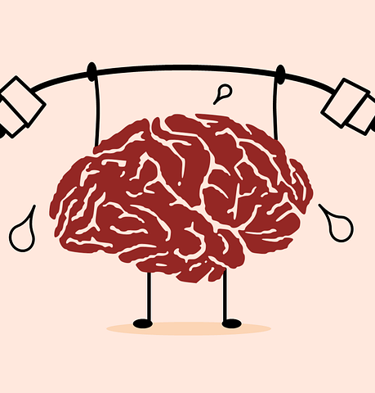
Mental Health and Wellbeing
It’s also important that you look after your mental health and wellbeing while you are at home.

Slide 12
What is Mental Health and Mental Wellbeing?
Mental health has a personal meaning for every individual. Here are some definitions of different aspects:
Mental wellbeing: a term that includes life satisfaction and how we feel about ourselves. This covers a range of things such as sense of control, having a purpose in life, a sense of belonging and positive relationships. Mental wellbeing can be experienced despite having a diagnosis of a mental health problem – in this respect mental health can be considered as two intersecting continua, mental wellbeing and mental health problems.
Mental health: used as an umbrella term to refer to both mental health problems and mental wellbeing.
Mental health problems: a term that refers to symptoms that meet the criteria for clinical diagnosis of mental health problems. Examples include depression, anxiety and eating disorders.
NHS Scotland

Slide 13
Mental Health and Mental Wellbeing
There are several different ways to do this and it’s important to remember that different approaches will work for different people!

Slide 14
Connect
Good relationships are important for your mental wellbeing. They can:
help you to build a sense of belonging and self-worth
give you an opportunity to share positive experiences
provide emotional support and allow you to support others

Slide 15
Connect
If possible, take time each day to be with your family, for example, try arranging a fixed time to eat dinner together.
Switch off the TV, put down your phone or turn off your Xbox to talk or play a game with your siblings, friends or family.
Make the most of technology to stay in touch with friends and family. Video-chat apps like Skype and FaceTime are useful, especially if you live far apart and during these times.

Slide 16
Connect
Do not rely on technology or social media alone to build relationships. It's easy to get into the habit of only ever texting, messaging or emailing people – give someone a call
Don’t break social distancing rules in order to connect.

Slide 17
Be physically active
Being active is not only great for your physical health and fitness. Evidence also shows it can also improve your mental wellbeing by:
raising your self-esteem
helping you to set goals or challenges and achieve them
causing chemical changes in your brain which can help to positively change your mood

Slide 18
Learn new skills
Research shows that learning new skills can also improve your mental wellbeing by:
boosting self-confidence and raising self-esteem
helping you to build a sense of purpose
helping you to connect with others
Remember to keep checking Twitter and Show My Homework for your different subjects and any other resources your teacher has given you for home learning!!!

Slide 19
Learn new skills
Try learning to cook something new. Find out about healthy eating and cooking tips.
Work on a DIY project, such as fixing a broken bike, garden gate or something bigger. There are lots of free video tutorials online.
Try new hobbies that challenge you, such as writing a blog, reading or learning to draw or paint.

Slide 20
Be kind to others
Research suggests that acts of giving and kindness can help improve your mental wellbeing by:
creating positive feelings and a sense of reward
giving you a feeling of purpose and self-worth
helping you connect with other people
It could be small acts of kindness towards other people, or larger ones like volunteering in your local community.

Slide 21
Be kind to others
Some examples of the things you could try include:
saying thank you to someone for something they have done for you
asking friends, family or colleagues how they are and really listening to their answer
spending time with friends or relatives who need support or company
offering to help someone you know with DIY or a work project
volunteering in your community, such as helping at a school, hospital or care home (this might be difficult in the current situation)

Slide 22
Anxiety
During this period some people may experience some nerves, distress or anxiety. Nerves are normal and can be a normal response to a variety of situations.
Anxiety is a stronger feeling of unease, worry or fear.
Watch the video below to gain a better understanding of this.
https://www.youtube.com/watch?v=kyG9HG4kJI4&feature=emb_title
The next few slides provides some strategies to deal with this.

Slide 23
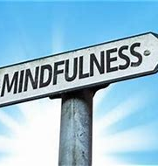
Mindfulness
Paying more attention to the present moment can improve your mental wellbeing. This includes your thoughts and feelings, your body and the world around you.
Mindfulness can help you enjoy life more and understand yourself better. It can positively change the way you feel about life and how you approach challenges. It can also help combat anxiety, low mood and depression.
Read more about mindfulness, including steps you can take to be more mindful in your everyday life.

Slide 24
Deep Breathing
This is a recognised approach used to deal with anger and fear and can help keep you calm in times of stress.
You can practice this anywhere.
The more you practice, the more natural it will become.

Slide 25
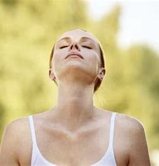
Deep Breathing
Close your eyes. Alternatively, you can keep your eyes open (and eventually you likely will) but closing your eyes helps you to focus on the mechanics of breathing and voids distraction.
Place one hand on your stomach and the other on your chest.
Take a few breaths as you normally would. Your stomach should rise and fall with every breath in (inhalation) and every breath out (exhalation)
Continue to take deep breaths, concentrating on only moving your belly. Breathe in for 3 and out for 5 (roughly)
Continue until you are calm.

Slide 26
Apps to help
https://drive.google.com/file/d/1kz83VqeX95EURNVJZhNZP2XU-hRWzoeQ/view
The link above has a recommendation of apps to help you deal with anxiety, stress and some other aspects of life.
Thanks to Lanark Grammar School
https://sites.google.com/prod/sl.glow.scot/lgswellbeingpack/anxiety
This Photo by Unknown Author is licensed under CC BY

Slide 27
Useful Links
https://www.nhs.uk/using-the-nhs/nhs-services/mental-health-services/camhs-information-for-children-and-young-people/
https://youngminds.org.uk/
http://www.actionforchildren.org.uk/support-for-parents/children-s-mental-health/how-can-you-help-with-children-and-young-peoples-mental-health/mental-health-resources-and-information/

Slide 28
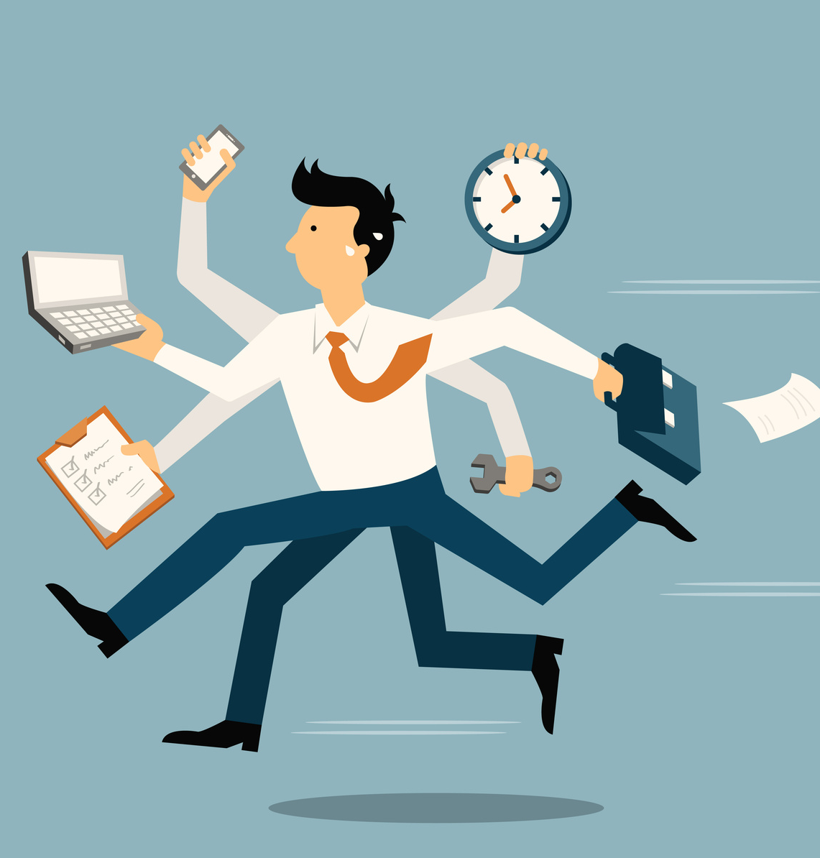
Stay busy
It’s important that develop some sort of routine whilst being off.
You should plan your day – including school work, time for physical activity, meals and time for yourself (read, Netflix, Xbox etc).
Keeping busy and accomplishing things with your day will give you a sense of fulfilment.
On the next page are various resources to help you plan.

Slide 29
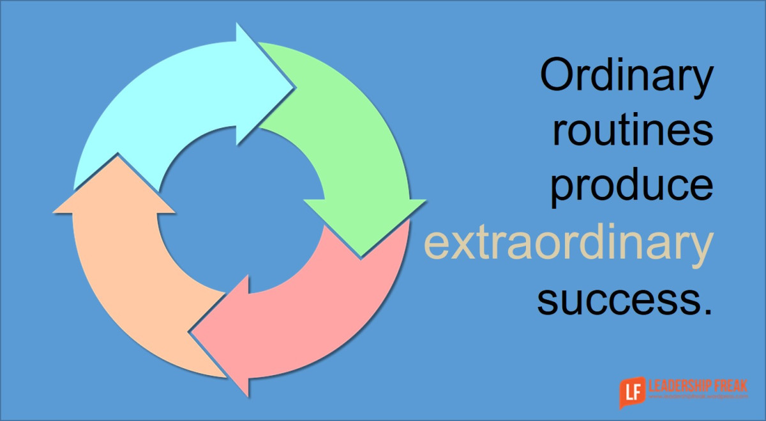
Stay busy
To do list - https://drive.google.com/file/d/1mDw0jbixJd_ju12wmJCVTqYrukipVH-T/view
An example of a daily routine - https://drive.google.com/file/d/1OQcMNlUKn_WCOW_EYfRbkAbRxk594rVZ/view
Set goals – list things you want to achieve with your day and tick them off as you complete!
Thanks again to Lanark Grammar School
https://sites.google.com/prod/sl.glow.scot/lgswellbeingpack/how-to-plan-your-day

Slide 30
Nutrition/Diet
While you’re off, don’t get lazy and don’t gorge on junk food!
A packet of crisps or a bar or chocolate is not suitable for breakfast lunch!

Slide 31
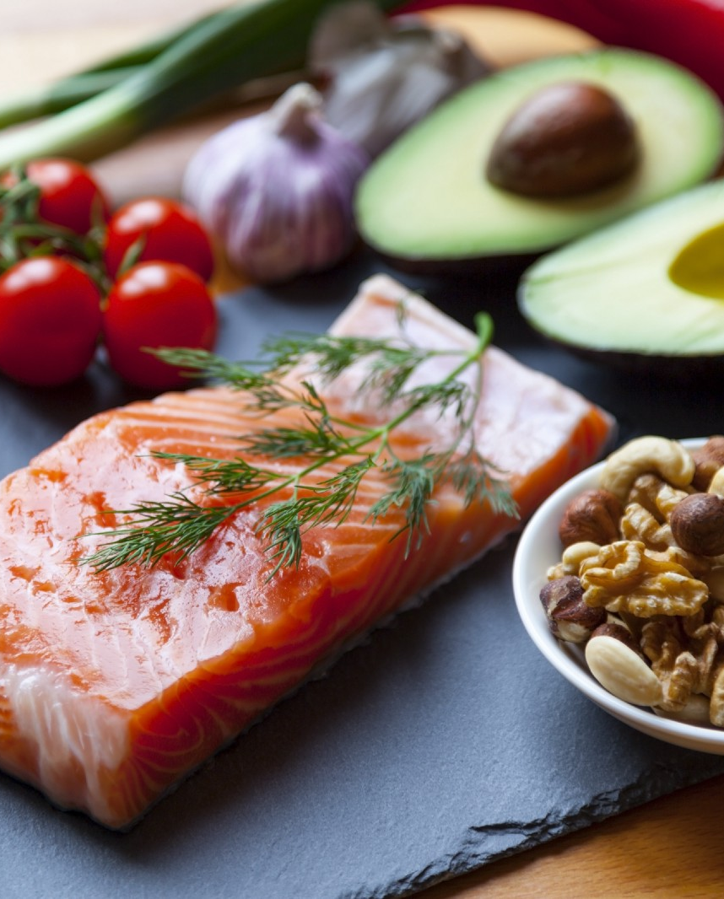
Nutrition/Diet
Eating a healthy, balanced diet is an important part of maintaining good health and can help you feel your best.
This means eating a wide variety of foods in the right proportions and consuming the right amount of food and drink to achieve and maintain a healthy body weight.
Please see this link for advice on achieving a healthy and balanced diet.
https://www.nhs.uk/live-well/eat-well/
People with special dietary needs or a medical condition should ask their doctor or a registered dietitian for advice.

Slide 32
Screen Time
Don’t be glued to your phone, Ipad, tablet or other electronic device during this time.
This is not healthy!!!
Whilst you may need these devices to stay connected during this time you should take regular breaks.
They should not interfere with things like exercising, sleep or other behaviours essential to a healthy lifestyle.

Slide 33
Screen Time
Eight screen time tips from the UK Chief Medical Officer
Sleep - leave phones outside the bedroom and get enough good-quality sleep
Education - make sure that children follow their school’s policy on screen time
Safety - advise children to put their phones away while crossing the road
Family time - put screens away at mealtime
Sharing sensibly - parents and carers should never assume that children are happy for their photos to be shared; when in doubt, don’t upload
Keep moving - get up and move every couple of hours after spending time sitting or lying down using a screen
Talk - make sure children know they can always speak to you or a responsible adult if they feel uncomfortable with screen or social media use
Tracking - make use of device or platform features that track how much time is spent using screens or social media.

Slide 34
Screen Time
Click the link below to access a list of apps that help you limit your screen time
https://www.digitaltrends.com/mobile/best-apps-for-limiting-your-screen-time/

Slide 35
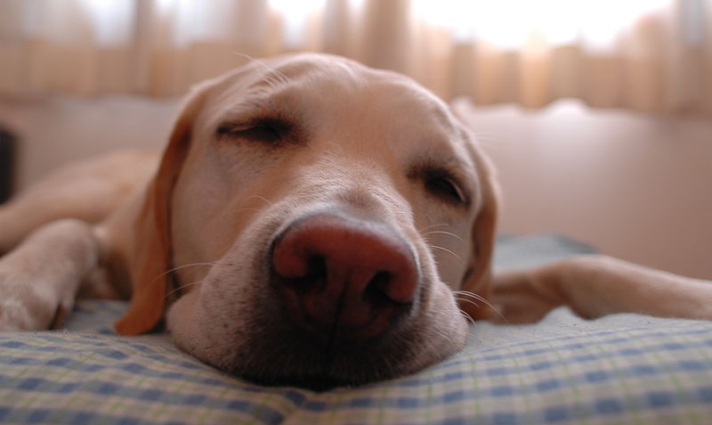
Sleep
A good night’s sleep is vitally important for your wellbeing.
Maintain regular sleeping hours. This programmes the brain and internal body clock to get used to a set routine.
Teenagers need 8-10 hours of sleep each night.
It is also important to try and wake up at the same time every day. While it may seem like a good idea to try to catch up on sleep after a bad night, doing so on a regular basis can also disrupt your sleep routine.
https://www.nhs.uk/live-well/sleep-and-tiredness/sleep-tips-for-teenagers/

Slide 36
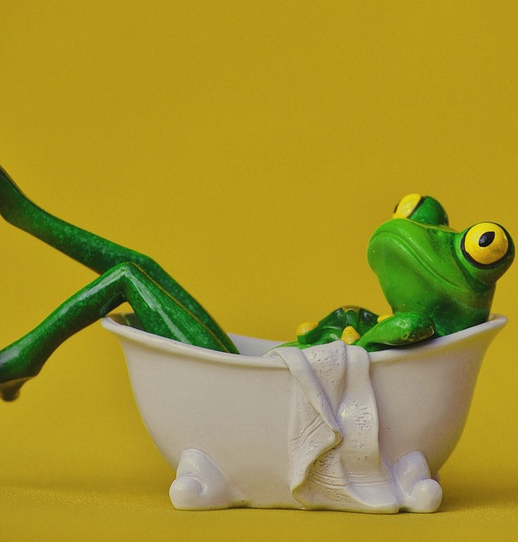
Winding down before sleep…
Consider:
a warm bath (not hot) will help your body reach a temperature that's ideal for rest.
writing "to do" lists for the next day can organise your thoughts and clear your mind of any distractions.
relaxation exercises, such as light yoga stretches, help to relax the muscles. Do not exercise vigorously, as it will have the opposite effect.
relaxing music
reading a book or listening to the radio relaxes the mind by distracting it
avoid using smartphones, tablets or other electronic devices for an hour or so before you go to bed as the light from the screen on these devices may have a negative effect on sleep

Slide 37
Acknowledgements
NHS
St Margaret Mary’s Secondary
Allan Campbell @ Lanark Grammar
Ryan McGinley @ Kilsyth Academy
https://www.digitaltrends.com
https://www.youtube.com/c/thebodycoachtv
For more tips on staying active and looking after your wellbeing please follow:
@Gleniffer_PE
@GlenifferHigh
@Gleniffer_PS
Remember to keep checking Show My Homework for updates too.
This Photo by Unknown Author is licensed under CC BY-SA

