Slide 1
Welcome to S1 October Assembly

Slide 2
Reminders
Uniform
Behaviour and effort expectations
Mobile Phone use
Litter in social area and around the school and wider community

Slide 3
Behaviour
Expectations
Merits & Demerits
Referrals
Alternative to Exclusion
Exclusion
Extra Curricular Activities

Slide 4
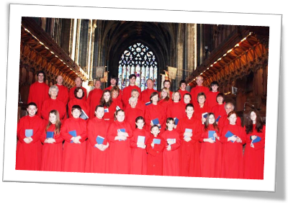
Paisley Abbey Choir
Dr George McPhee

Slide 5
School Values and Wellbeing Indicators
Acceptance
Ambition
Nurture
Respect
Trust
Safe
Healthy
Achieving
Nurtured
Active
Respected
Responsible
Included

Slide 6
Ambition
A strong desire and determination
to achieve success

Slide 7
Ambition

Slide 8
Positive mind. Positive life.
What’s your ambition?
What’s the one thing you will work toward achieving – in or out of school?

Slide 9
S1 Extra Curricular Awards

Slide 10
S1 Extra Curricular Awards October 2019
Kyle | MacKay | S1 | Silver | Sport/Fitness
Kyle | MacKay | S1 | Silver | Charity/Citizenship

Slide 11
Extra Curricular P.E Clubs S1
Monday – Netball – Mrs Thomson
Tuesday – Gymnastics – Mrs Frew
Boxercise – Miss Lambie
Hockey – Mr Bleach
Wednesday – Basketball – Miss Crawford
Multi-sports – Miss Robb
Fitness – Mrs MacDougall
Thursday – Volleyball – Mr Giles
Friday – Football – James Rae
Please speak to teacher involved or just come along to P.E on the chosen day

Slide 12
As a school community we are promoting positive mental health by:
#HelloYellow, wear something yellow in aid of supporting young people with mental health.
Staff and pupil tea and talk events at break time/ lunchtime.
Mental health YouTube videos will be shown on the TV in the social area.
Mental health statistics will be displayed in the social area.
Pupils will have access to and be able to add to an anxiety support board.
A helpline and support poster board will be made available to all staff and pupils.
Origami kindness messages will be sold.

Slide 14
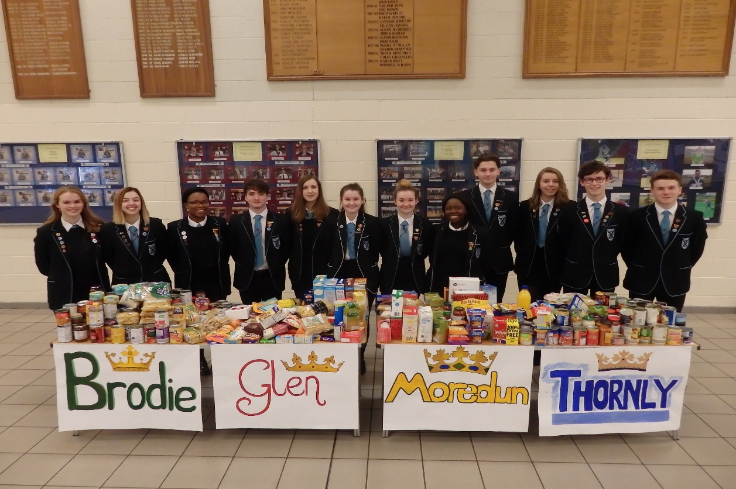
Foodbank Appeal Monday 7th – Thursday 10th October

Slide 15
Coming Soon………….

Slide 16
Good, better, best.
Never let it rest.
Till your good is better and your better is best!!!

